Slide 1
Inverse Optimal Control in Linearly-Solvable Markov Decision Processes with Delayed Observations

Slide 2

Linearly-Solvable Markov Decision Problem (LMDP)
4
3
2
In this example, each square represents a state.
1
Particle
0
Obstacle
-4
Obstacle
-3
-2
Goal
-1
-1
-2
-3
-4
0
1
2
3
4

Slide 3
Linearly-Solvable Markov Decision Problem (LMDP)
4
3
In an LMDP, we abstract away the concept of actions.
Only state transitions are considered (e.g., the particle transitions from coordinate (0,0) to coordinate (1,1)).
2
1
0
-4
-3
-2
-1
-1
-2
-3
-4
0
1
2
3
4

Slide 4
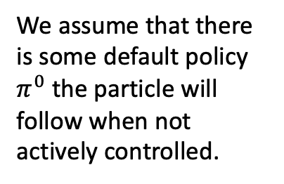
Linearly-Solvable Markov Decision Problem (LMDP)
4
3
We assume that there is some default policy $π^{0}$ the particle will follow when not actively controlled.
2
1
0
-4
-3
-2
-1
-1
-2
-3
-4
0
1
2
3
4

Slide 5
Linearly-Solvable Markov Decision Problem (LMDP)
4
3
Transition probabilities under
uniform default policy
We assume that there is some default policy $π^{0}$ the particle will follow when not actively controlled.
2
1
1/4
0
1/4
1/4
-4
1/4
-3
-2
-1
-1
-2
-3
-4
0
1
2
3
4

Slide 6
Linearly-Solvable Markov Decision Problem (LMDP)
4
3
A controller can instead impose their own policy onto the particle at some accumulated cost.
The objective is then to develop an optimal policy (known as the optimal control law), that minimizes the cost of control.
2
1
0
-4
-3
-2
-1
-1
-2
-3
-4
0
1
2
3
4

Slide 7
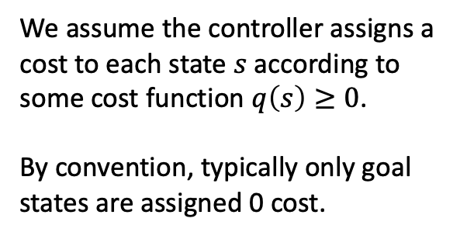
Linearly-Solvable Markov Decision Problem (LMDP)
4
1
1
1
1
1
1
1
1
1
3
1
1
1
1
1
1
1
1
1
2
1
1
1
1
1
1
1
1
1
1
1
1
1
1
1
1
1
1
1
1
We assume the controller assigns a cost to each state $s$ according to some cost function $q\left(s\right)≥0$.
By convention, typically only goal states are assigned 0 cost.
0
1
1
1
1
1
1
1
1
-4
5
1
1
1
1
1
1
1
1
-3
1
1
1
1
5
1
1
1
1
-2
1
1
1
1
1
1
1
1
1
-1
0
1
1
1
1
1
1
1
1
-1
-2
-3
-4
0
1
2
3
4

Slide 8
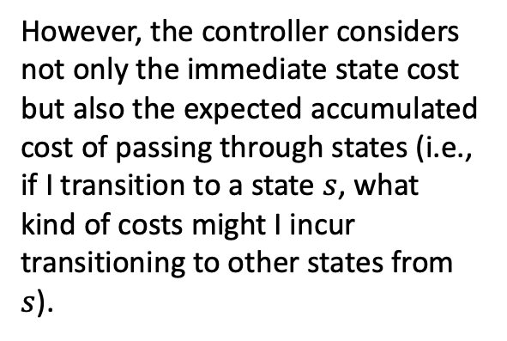
Linearly-Solvable Markov Decision Problem (LMDP)
However, the controller considers not only the immediate state cost but also the expected accumulated cost of passing through states (i.e., if I transition to a state $s$, what kind of costs might I incur transitioning to other states from $s$).
4
4
4
4
4
4
4
4
4
5
3
3
3
3
3
3
3
3
3
4
2
2
2
2
2
2
2
2
3
4
1
1
1
1
1
1
1
2
3
4
0
4
3
1
1
1
2
2
3
4
-4
5
3
1
2
4
3
2
3
4
-3
2
2
.2
2
5
4
2
3
4
-2
.1
.1
.2
2
3
4
2
3
4
-1
0
.1
.2
.4
.5
1
2
3
4
-1
-2
-3
-4
0
1
2
3
4

Slide 9
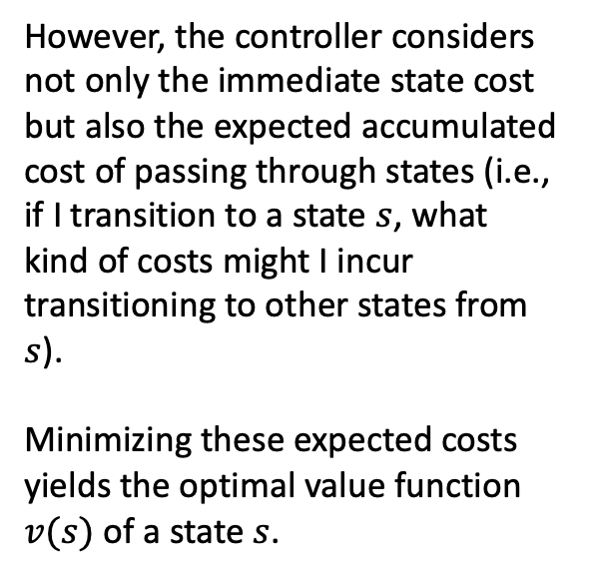
Linearly-Solvable Markov Decision Problem (LMDP)
However, the controller considers not only the immediate state cost but also the expected accumulated cost of passing through states (i.e., if I transition to a state $s$, what kind of costs might I incur transitioning to other states from $s$).
Minimizing these expected costs yields the optimal value function $v(s)$ of a state $s$.
4
4
4
4
4
4
4
4
4
5
3
3
3
3
3
3
3
3
3
4
2
2
2
2
2
2
2
2
3
4
1
1
1
1
1
1
1
2
3
4
0
4
3
1
1
1
2
2
3
4
-4
5
3
1
2
4
3
2
3
4
-3
2
2
.2
2
5
4
2
3
4
-2
.1
.1
.2
2
3
4
2
3
4
-1
0
.1
.2
.4
.5
1
2
3
4
-1
-2
-3
-4
0
1
2
3
4

Slide 10
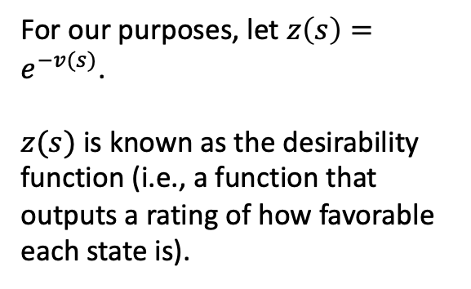
Linearly-Solvable Markov Decision Problem (LMDP)
4
.018
.018
.018
.018
.018
.018
.018
.018
.007
3
.05
.05
.05
.05
.05
.05
.05
.05
.018
For our purposes, let $z\left(s\right)=e^{−v(s)}$.
$z(s)$ is known as the desirability function (i.e., a function that outputs a rating of how favorable each state is).
2
.135
.135
.135
.135
.135
.135
.135
.05
.018
1
.368
.368
.368
.368
.368
.368
.135
.05
.018
0
.018
.05
.368
.368
.368
.135
.135
.05
.018
-4
.007
.05
.368
.135
.018
.05
.135
.05
.018
-3
.135
.135
.819
.135
.007
.018
.135
.05
.018
-2
.905
.905
.819
.135
.05
.018
.135
.05
.018
-1
1
.905
.819
.670
.607
.368
.135
.05
.018
-1
-2
-3
-4
0
1
2
3
4

Slide 11
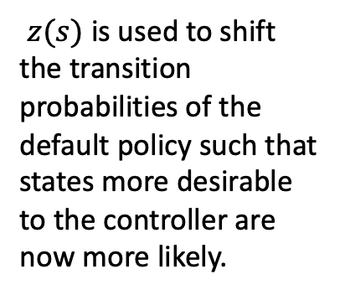
Linearly-Solvable Markov Decision Problem (LMDP)
$z(s)$ is used to shift the transition probabilities of the default policy such that states more desirable to the controller are now more likely.
4
3
Transition probabilities under the optimal control law
2
1
1/3
0
1/3
1/4
-4
1/12
-3
-2
-1
-1
-2
-3
-4
0
1
2
3
4

Slide 12
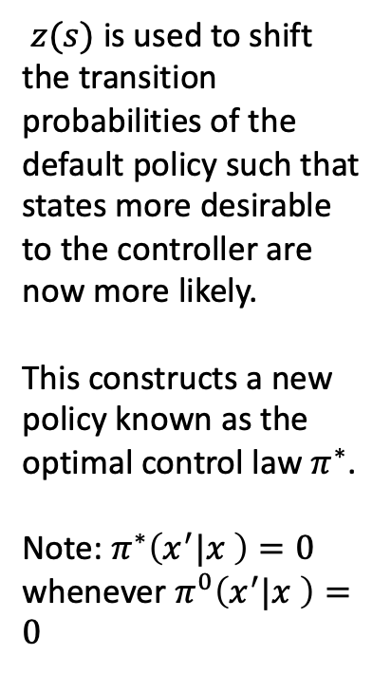
Linearly-Solvable Markov Decision Problem (LMDP)
$z(s)$ is used to shift the transition probabilities of the default policy such that states more desirable to the controller are now more likely.
This constructs a new policy known as the optimal control law $π^{∗}$.
Note: $π^{∗}\left(x^{′}|x \right)=0$ whenever $π^{0}\left(x^{′}|x \right)=0$
4
3
Transition probabilities under the optimal control law
2
1
1/3
0
1/3
1/4
-4
1/12
-3
-2
-1
-1
-2
-3
-4
0
1
2
3
4

Slide 13
Linearly-Solvable Markov Decision Problem (LMDP)
4
3
Using an optimal state sequence algorithm like Viterbi on the optimal control law can generate optimal trajectories.
2
1
0
-4
-3
-2
-1
-1
-2
-3
-4
0
1
2
3
4

Slide 14
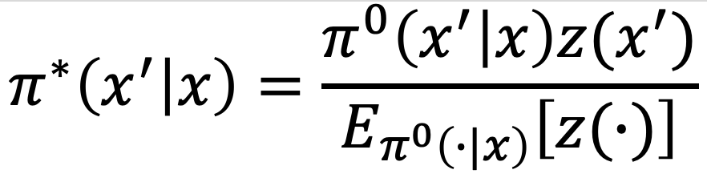
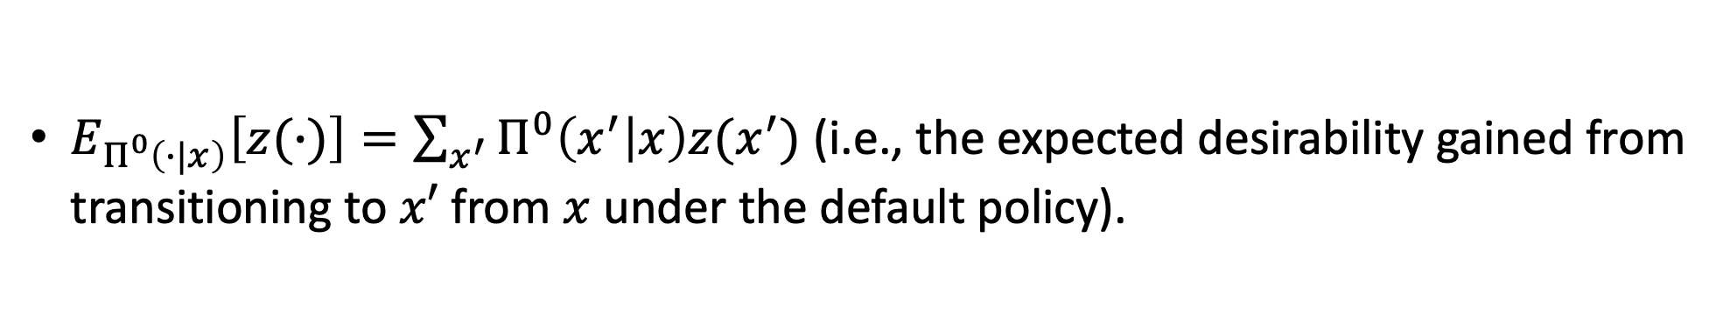
Optimal Control Law
$E_{Π^{0}\left(∙|x\right)}\left[z(∙)\right]=\sum_{x^{′}}{Π^{0}\left(x^{′} | x\right)z(x^{′})}$ (i.e., the expected desirability gained from transitioning to $x′$ from $x$ under the default policy).

Slide 15
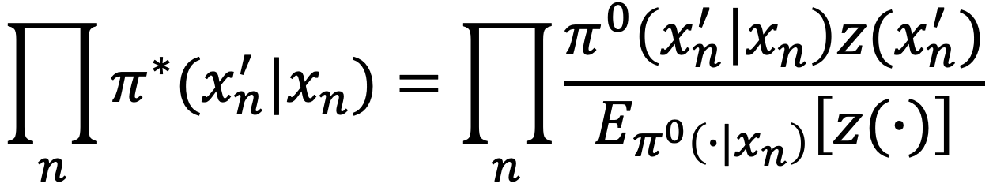
Probability of Trajectories Under Optimal Control Law
Given a set of observed state transitions ${\{x_{n},x_{n}^{′}\}}_{n=1,…,N}$, the above equation computes the likelihood of this trajectory under the optimal control law.

Slide 16
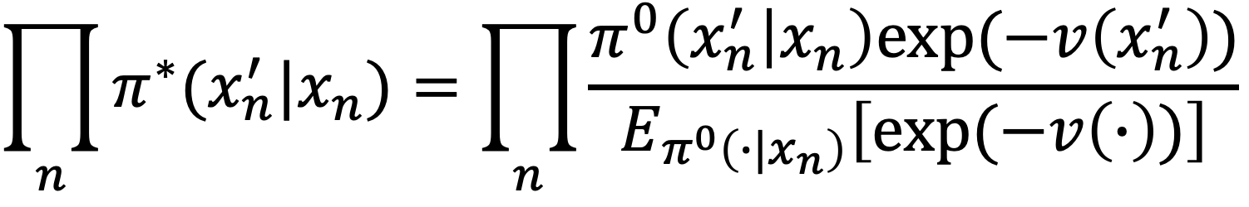
Probability of Trajectories Under Optimal Control Law
We can also write this likelihood in terms of the Optimal Value Function as shown above.

Slide 17
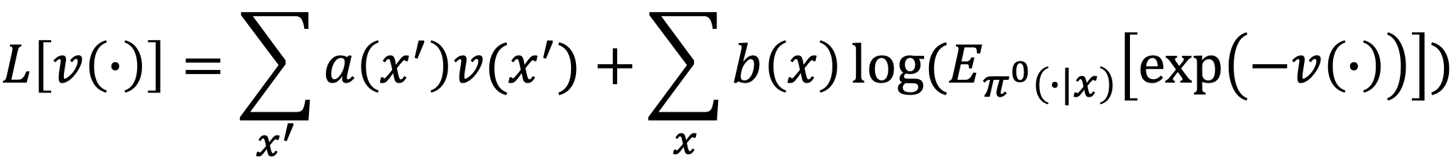
Joint Negative Log-Likelihood (Loss Function) of the State Values
$a\left(x^{′}\right)$ is a count of how many times it was observed that there was a transition to state $x′$.

Slide 18
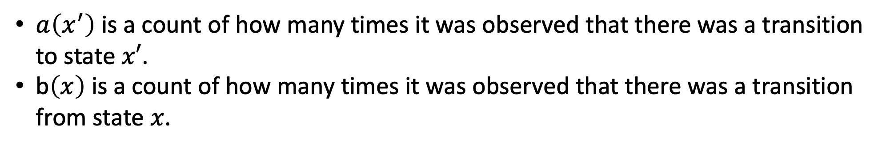
Joint Negative Log-Likelihood (Loss Function) of the State Values
$a\left(x^{′}\right)$ is a count of how many times it was observed that there was a transition to state $x′$.
b$\left(x\right)$ is a count of how many times it was observed that there was a transition from state $x$.

Slide 19
Inverse Reinforcement Learning for LMDP (aka Inverse Optimal Control)
We want to infer $v(x′)$ for all states $x′$ for a given controller to characterize its behavior.

Slide 20
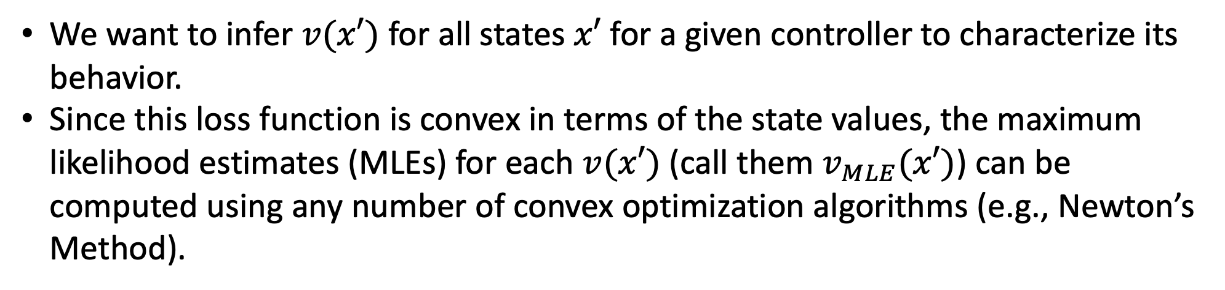
Inverse Reinforcement Learning for LMDP (aka Inverse Optimal Control)
We want to infer $v(x′)$ for all states $x′$ for a given controller to characterize its behavior.
Since this loss function is convex in terms of the state values, the maximum likelihood estimates (MLEs) for each $v(x′)$ (call them $v_{MLE}(x′)$) can be computed using any number of convex optimization algorithms (e.g., Newton’s Method).

Slide 21
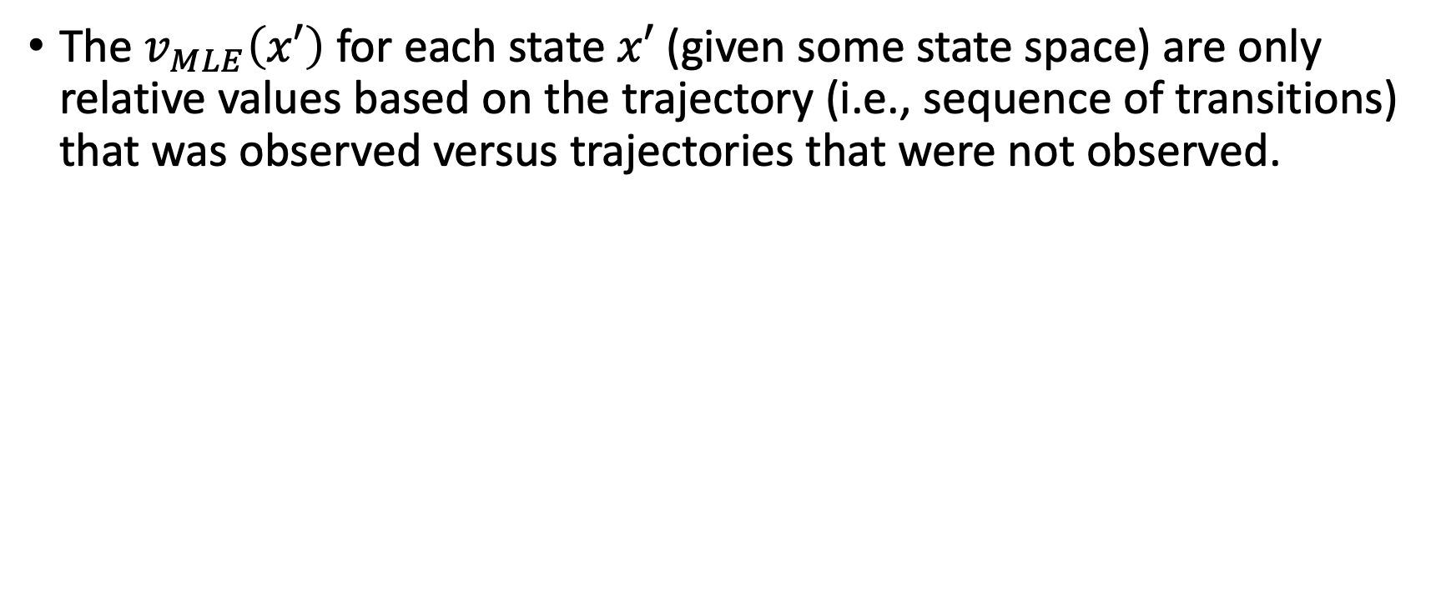
Feature-Based Approximations of the Optimal Value Function
The $v_{MLE}\left(x′\right)$ for each state $x′$ (given some state space) are only relative values based on the trajectory (i.e., sequence of transitions) that was observed versus trajectories that were not observed.

Slide 22
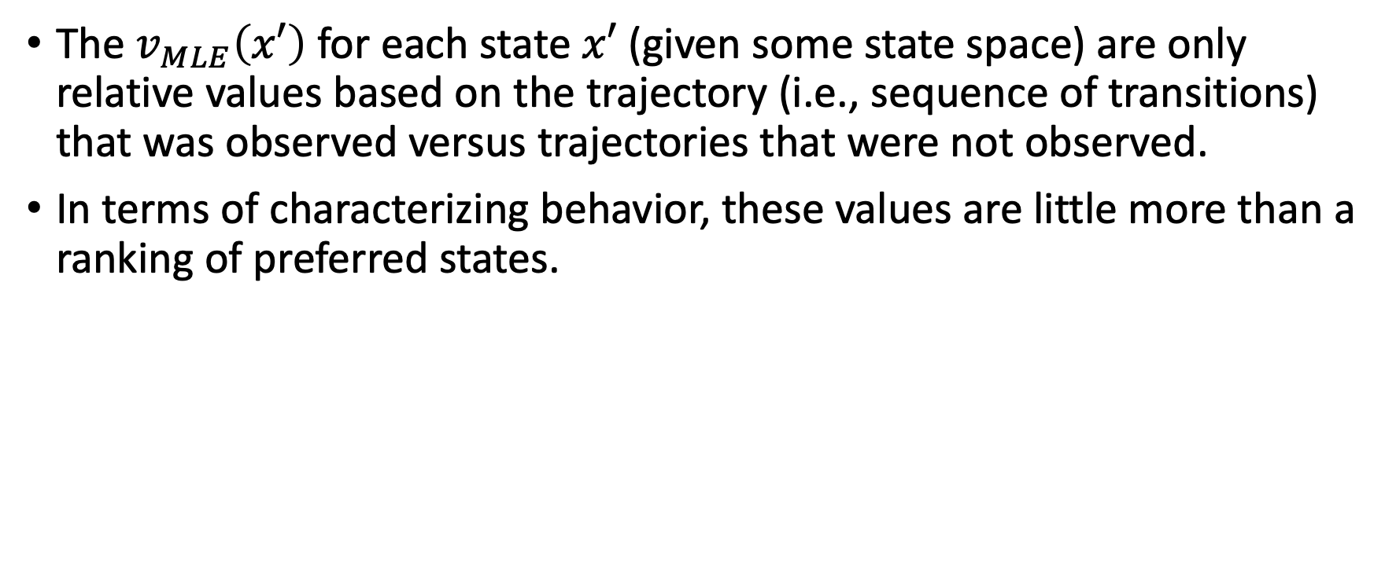
Feature-Based Approximations of the Optimal Value Function
The $v_{MLE}\left(x′\right)$ for each state $x′$ (given some state space) are only relative values based on the trajectory (i.e., sequence of transitions) that was observed versus trajectories that were not observed.
In terms of characterizing behavior, these values are little more than a ranking of preferred states.

Slide 23
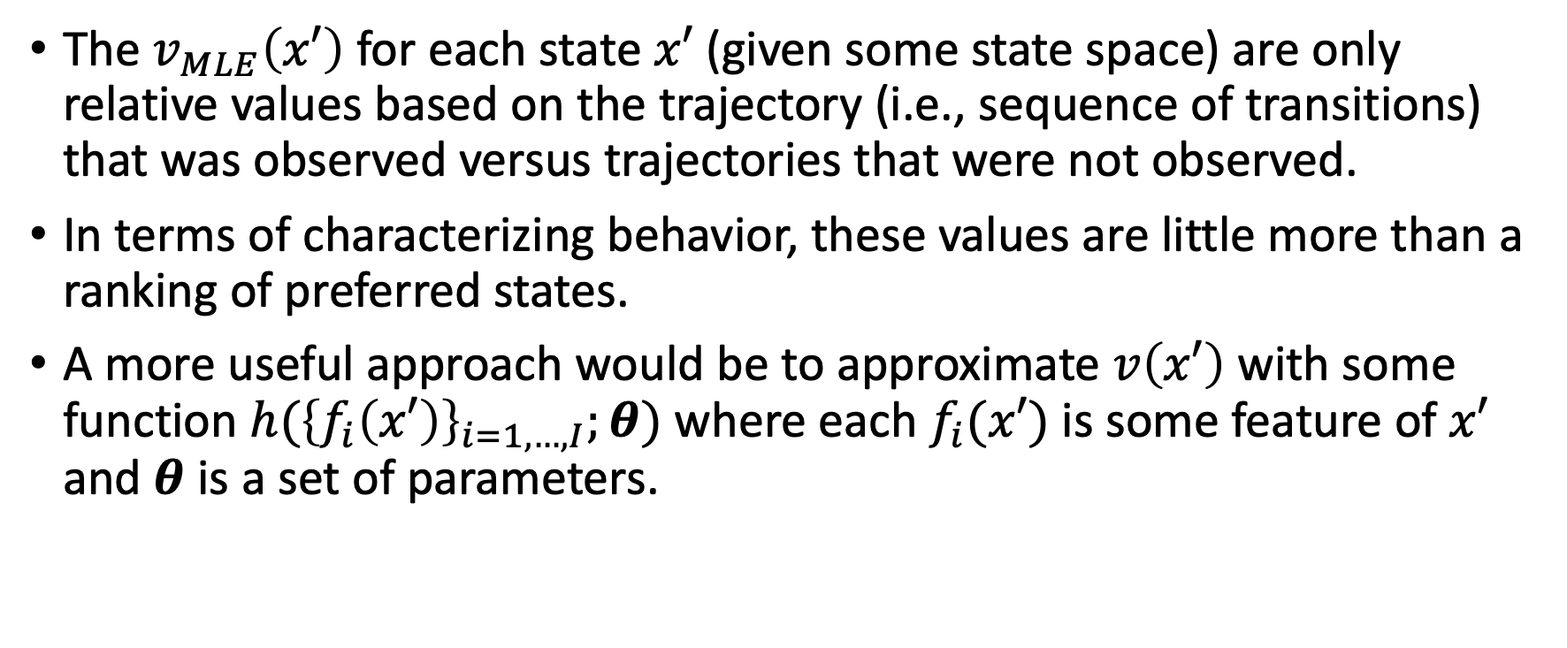
Feature-Based Approximations of the Optimal Value Function
The $v_{MLE}\left(x′\right)$ for each state $x′$ (given some state space) are only relative values based on the trajectory (i.e., sequence of transitions) that was observed versus trajectories that were not observed.
In terms of characterizing behavior, these values are little more than a ranking of preferred states.
A more useful approach would be to approximate $v\left(x′\right)$ with some function $h({\left\{f_{i}\left(x′\right)\right\}}_{i=1,…,I};θ)$ where each $f_{i}(x′)$ is some feature of $x′$ and $θ$ is a set of parameters.

Slide 24
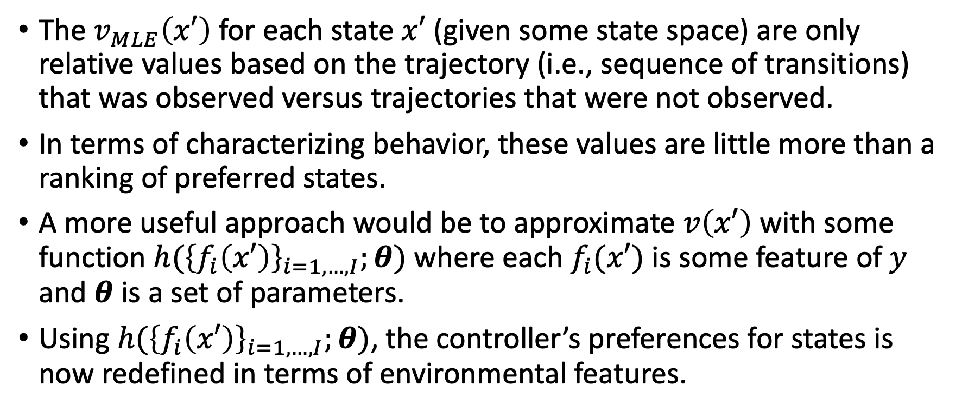
Feature-Based Approximations of the Optimal Value Function
The $v_{MLE}\left(x′\right)$ for each state $x′$ (given some state space) are only relative values based on the trajectory (i.e., sequence of transitions) that was observed versus trajectories that were not observed.
In terms of characterizing behavior, these values are little more than a ranking of preferred states.
A more useful approach would be to approximate $v\left(x′\right)$ with some function $h({\left\{f_{i}\left(x′\right)\right\}}_{i=1,…,I};θ)$ where each $f_{i}(x′)$ is some feature of $y$ and $θ$ is a set of parameters.
Using $h({\left\{f_{i}\left(x′\right)\right\}}_{i=1,…,I};θ)$, the controller’s preferences for states is now redefined in terms of environmental features.

Slide 25
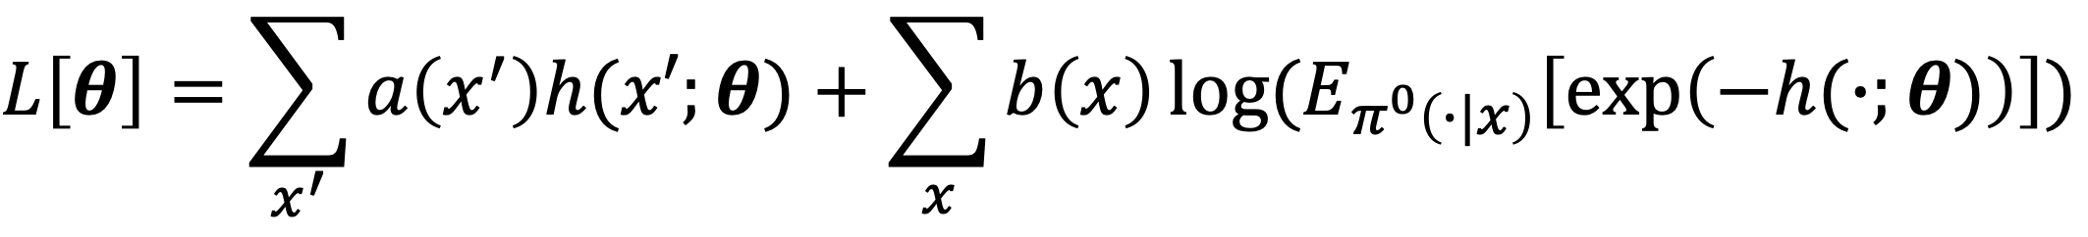
Feature-Based Inverse Optimal Control
Plugging in $h$ (shortened to $h(x^{′};θ)$) for $v$ gives a loss function $L[θ]$.

Slide 26
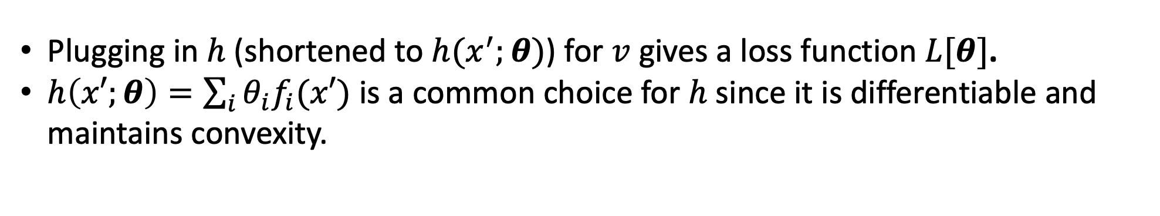
Feature-Based Inverse Optimal Control
Plugging in $h$ (shortened to $h(x^{′};θ)$) for $v$ gives a loss function $L[θ]$.
$h\left(x′;θ\right)=\sum_{i}{θ_{i}f_{i}(x′)}$ is a common choice for $h$ since it is differentiable and maintains convexity.

Slide 27
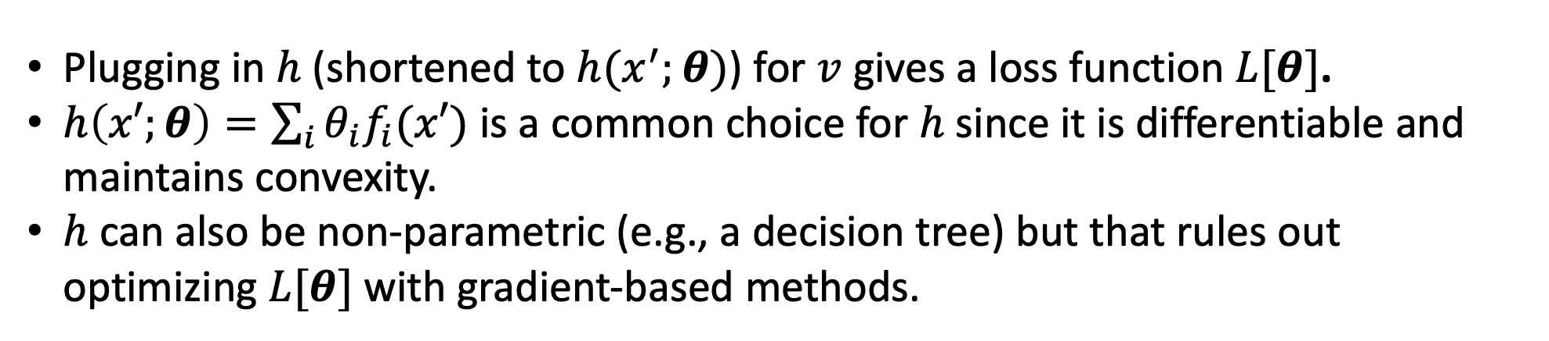
Feature-Based Inverse Optimal Control
Plugging in $h$ (shortened to $h(x^{′};θ)$) for $v$ gives a loss function $L[θ]$.
$h\left(x′;θ\right)=\sum_{i}{θ_{i}f_{i}(x′)}$ is a common choice for $h$ since it is differentiable and maintains convexity.
$h$ can also be non-parametric (e.g., a decision tree) but that rules out optimizing $L[θ]$ with gradient-based methods.

Slide 28
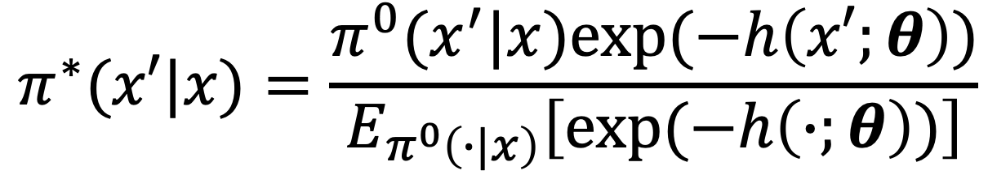
Softmax and Cross-Entropy Loss

Slide 29
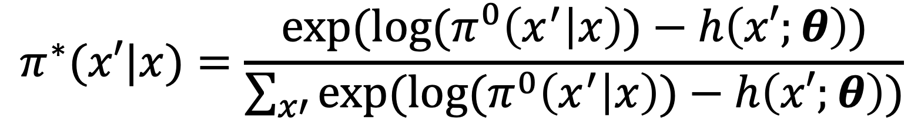
Softmax and Cross-Entropy Loss

Slide 30
Softmax and Cross-Entropy Loss

Slide 31
Softmax and Cross-Entropy Loss
$L[θ]$ ends up being a cross-entropy loss function.

Slide 32
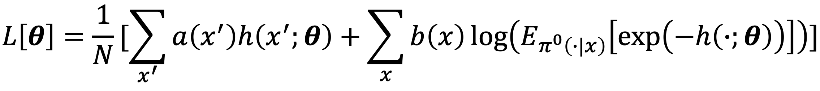
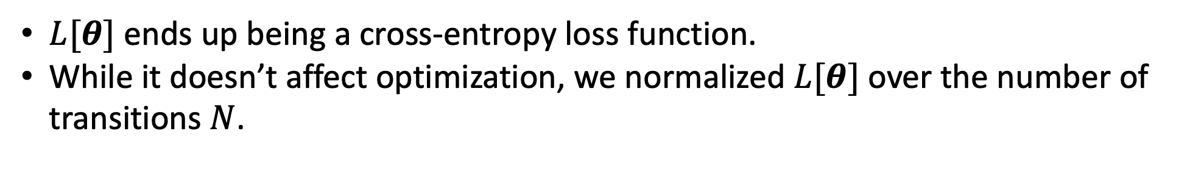
Softmax and Cross-Entropy Loss
$L[θ]$ ends up being a cross-entropy loss function.
While it doesn’t affect optimization, we normalized $L[θ]$ over the number of transitions $N$.

Slide 33
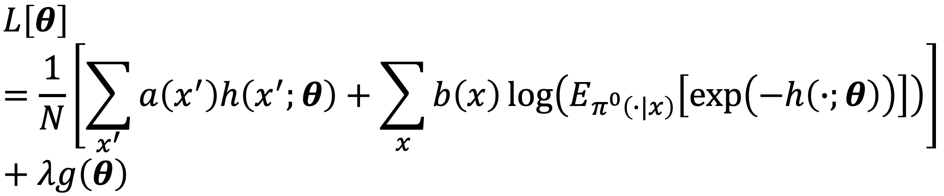
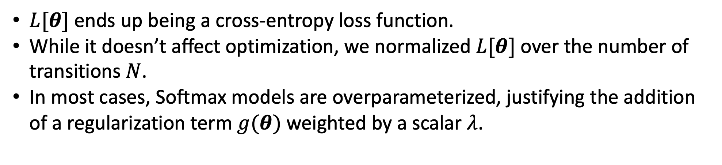
Softmax and Cross-Entropy Loss
$L[θ]$ ends up being a cross-entropy loss function.
While it doesn’t affect optimization, we normalized $L[θ]$ over the number of transitions $N$.
In most cases, Softmax models are overparameterized, justifying the addition of a regularization term $g(θ)$ weighted by a scalar $λ$.

Slide 34
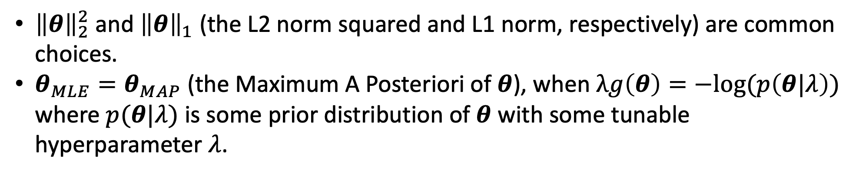
Regularization
${\left\|θ\right\|}_{2}^{2}$ and ${\left\|θ\right\|}_{1}$ (the L2 norm squared and L1 norm, respectively) are common choices.
$θ_{MLE}=θ_{MAP}$ (the Maximum A Posteriori of $θ$), when $λg\left(θ\right)=−log⁡(p\left(θ|λ\right))$ where $p(θ|λ)$ is some prior distribution of $θ$ with some tunable hyperparameter $λ$.

Slide 35
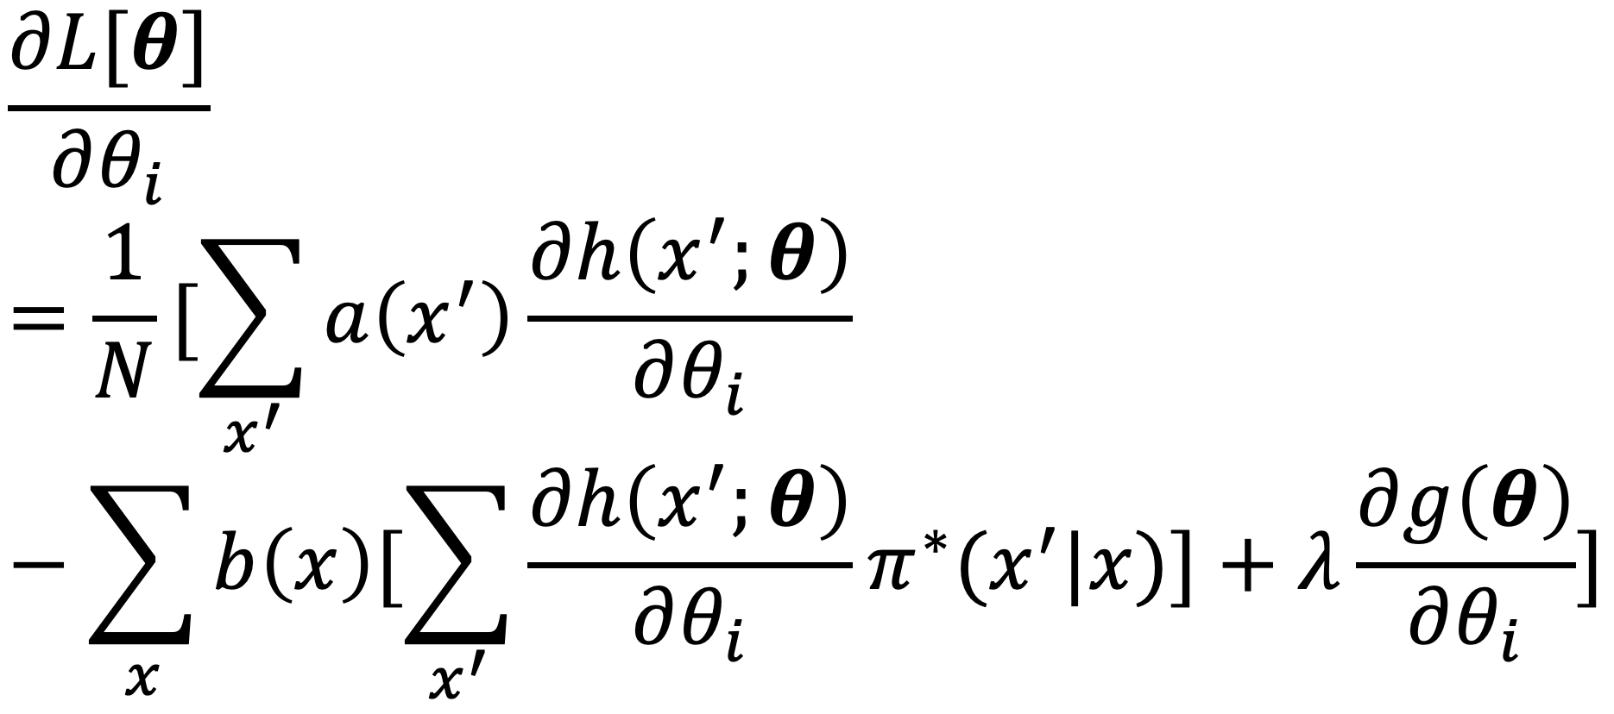
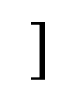
The Gradient of the Loss Function
$$]$$

Slide 36
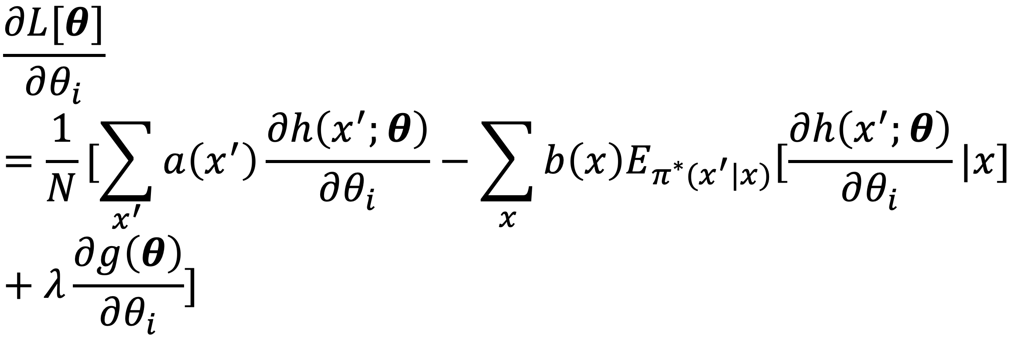
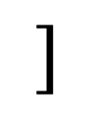
The Gradient of the Loss Function
$$]$$

Slide 37
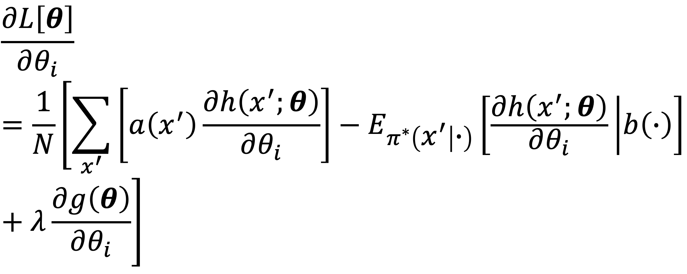

The Gradient of the Loss Function

Slide 38
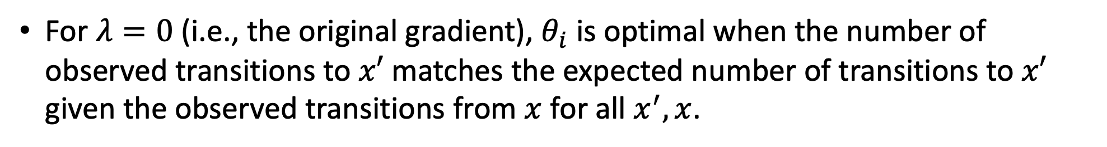
The Gradient of the Loss Function
For $λ=0$ (i.e., the original gradient), $θ_{i}$ is optimal when the number of observed transitions to $x′$ matches the expected number of transitions to $x′$ given the observed transitions from $x$ for all $x^{′},x$.

Slide 39
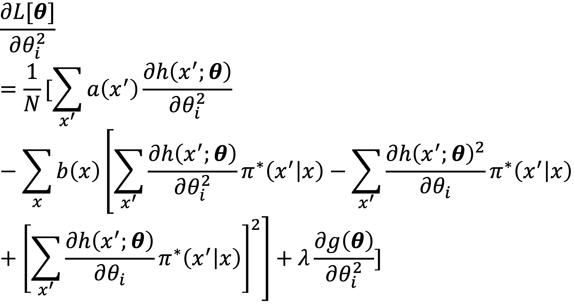
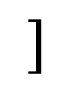
The Hessian of the Loss Function(Diagonal)
$$]$$

Slide 40
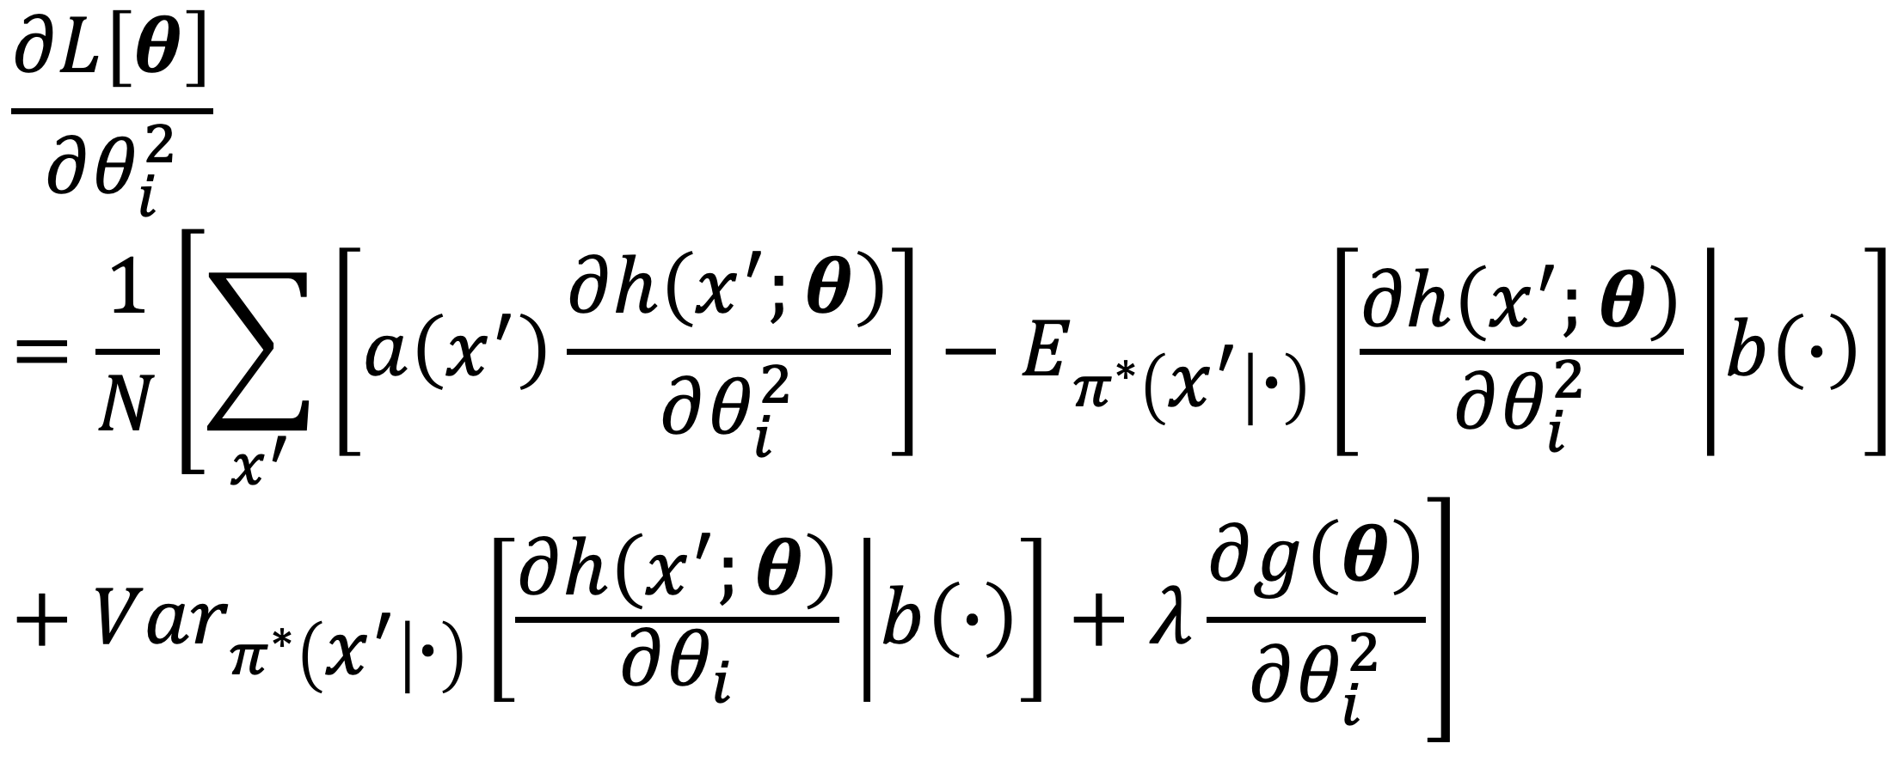

The Hessian of the Loss Function(Diagonal)

Slide 41
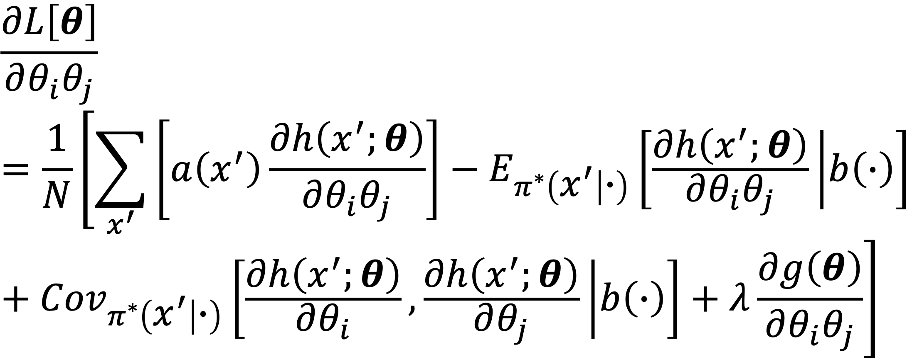
The Hessian of the Loss Function(Off-Diagonal)

Slide 42
LMDP with a dynamic environment
4
3
2
1
Goal
Particle
0
-4
-3
-2
-1
-1
-2
-3
-4
0
1
2
3
4

Slide 43
LMDP with a dynamic environment
4
Ideally, the controller will choose and execute an appropriate transition, update its knowledge of the obstacle positions, and recompute state costs.
3
2
1
Goal
Particle
0
-4
-3
-2
-1
-1
-2
-3
-4
0
1
2
3
4

Slide 44
LMDP with a dynamic environment
4
Ideally, the controller will choose and execute an appropriate transition, update its knowledge of the obstacle positions, and recompute state costs.
3
2
1
0
-4
-3
-2
-1
-1
-2
-3
-4
0
1
2
3
4

Slide 45
LMDP with a dynamic environment
4
Ideally, the controller will choose and execute an appropriate transition, update its knowledge of the obstacle positions, and recompute state costs.
In fact, we assume the data is readily available for inference under these conditions (i.e., there are no missing observations from the observer’s point of view).
3
2
1
0
-4
-3
-2
-1
-1
-2
-3
-4
0
1
2
3
4

Slide 46
LMDP with Delayed Observations

Slide 47
LMDP with Delayed Observations
However, in some cases, especially if the controller is human, it is unrealistic to assume that they utilize the same amount of environmental data that our sensors have collected.

Slide 48
LMDP with Delayed Observations
However, in some cases, especially if the controller is human, it is unrealistic to assume that they utilize the same amount of environmental data that our sensors have collected.
More specifically, there are cases where the controller must make decisions faster than they can observe environmental changes (i.e., their observations are delayed).

Slide 49
LMDP with Delayed Observations
Under these conditions, the controller must use their best judgment on how to proceed until they receive new environmental observations.

Slide 50
LMDP with Delayed Observations
This can lead to success…

Slide 51
LMDP with Delayed Observations
Or this can lead to failure…

Slide 52
LMDP with Delayed Observations
4
To handle these delayed observations, our model assumes that the controller “freezes” its current beliefs about the environment (e.g., the current locations of the obstacles).
3
2
1
0
-4
-3
-2
-1
-1
-2
-3
-4
0
1
2
3
4

Slide 53
LMDP with Delayed Observations
4
Likewise, as seen in the example, we assume the controller attempts to reduce cognitive load by only considering a smaller, localized state space.
3
2
1
0
-4
-3
-2
-1
-1
-2
-3
-4
0
1
2
3
4

Slide 54
LMDP with Delayed Observations
4
Likewise, as seen in the example, we assume the controller attempts to reduce cognitive load by only considering a smaller, localized state space.
However, this may not be necessary in smaller domains.
3
2
1
0
-4
-3
-2
-1
-1
-2
-3
-4
0
1
2
3
4

Slide 55
LMDP with Delayed Observations
4
Likewise, as seen in the example, we assume the controller attempts to reduce cognitive load by only considering a smaller, localized state space.
However, this may not be necessary in smaller domains.
Note: Our current approach only considers discrete state spaces.
3
2
1
0
-4
-3
-2
-1
-1
-2
-3
-4
0
1
2
3
4

Slide 56
LMDP with Delayed Observations
4
Given their current beliefs, the controller attempts to generate an optimal plan within the localized state space.
3
2
1
0
-4
-3
-2
-1
-1
-2
-3
-4
0
1
2
3
4

Slide 57
LMDP with Delayed Observations
4
Given their current beliefs, the controller attempts to generate an optimal plan within the localized state space.
Planning often involves considering future environmental states given their current beliefs (i.e., where are the obstacles likely to be in the next few moments given where they are now?)
3
2
1
0
-4
-3
-2
-1
-1
-2
-3
-4
0
1
2
3
4

Slide 58
LMDP with Delayed Observations
4
Once the controller decides on a plan, it attempts to execute it.
3
2
1
0
-4
-3
-2
-1
-1
-2
-3
-4
0
1
2
3
4

Slide 59
LMDP with Delayed Observations
4
Once the controller decides on a plan, it attempts to execute it.
If new updates become available during execution, the controller will stop and replan under an updated localized state space.
3
2
1
0
-4
-3
-2
-1
-1
-2
-3
-4
0
1
2
3
4

Slide 60
LMDP with Delayed Observations
4
Once the controller decides on a plan, it attempts to execute it.
If new updates become available during execution, the controller will stop and replan under an updated localized state space.
3
2
1
0
-4
-3
-2
-1
-1
-2
-3
-4
0
1
2
3
4

Slide 61
LMDP with Delayed Observations
4
3
Once the controller decides on a plan, it attempts to execute it.
If new updates become available during execution, the controller will stop and replan under an updated localized state space.
2
1
0
-4
-3
-2
-1
-1
-2
-3
-4
0
1
2
3
4

Slide 62
LMDP with Delayed Observations
4
3
Once the controller decides on a plan, it attempts to execute it.
If new updates become available during execution, the controller will stop and replan under an updated localized state space.
This proceeds until a goal (or failure) is reached.
2
1
0
-4
-3
-2
-1
-1
-2
-3
-4
0
1
2
3
4

Slide 63
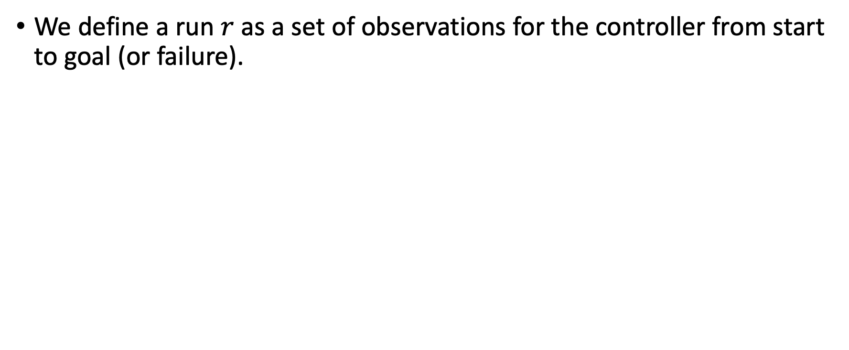
Partitioned Runs
We define a run $r$ as a set of observations for the controller from start to goal (or failure).

Slide 64
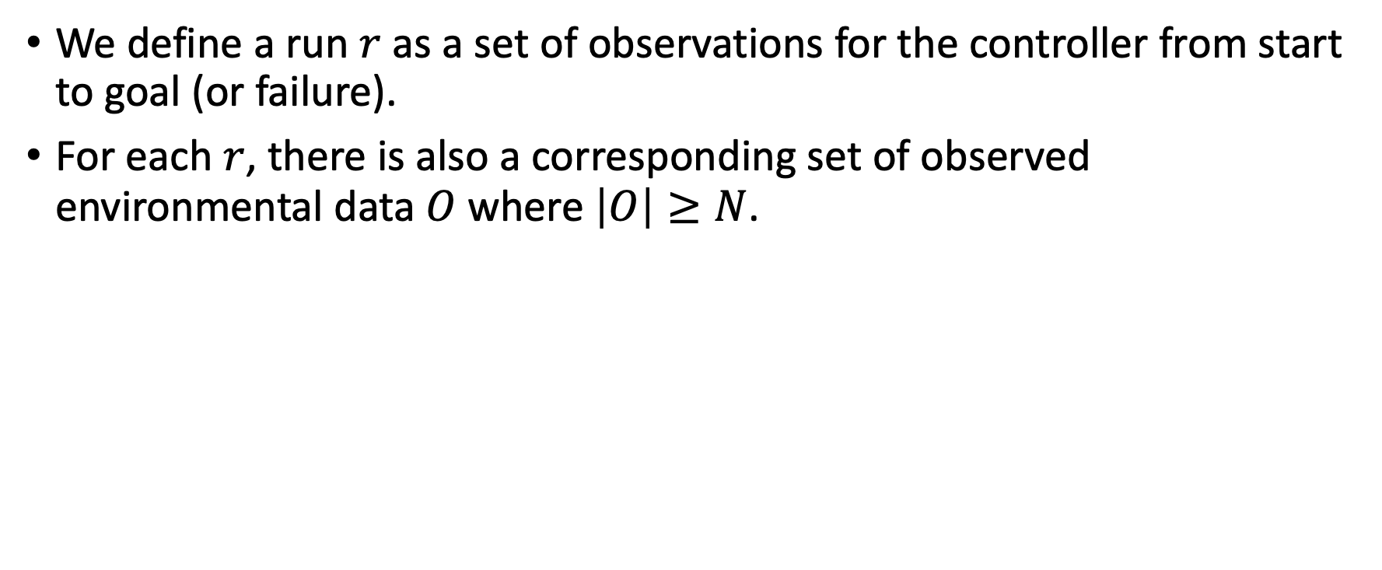
Partitioned Runs
We define a run $r$ as a set of observations for the controller from start to goal (or failure).
For each $r$, there is also a corresponding set of observed environmental data $O$ where $\left|O\right|≥N$.

Slide 65
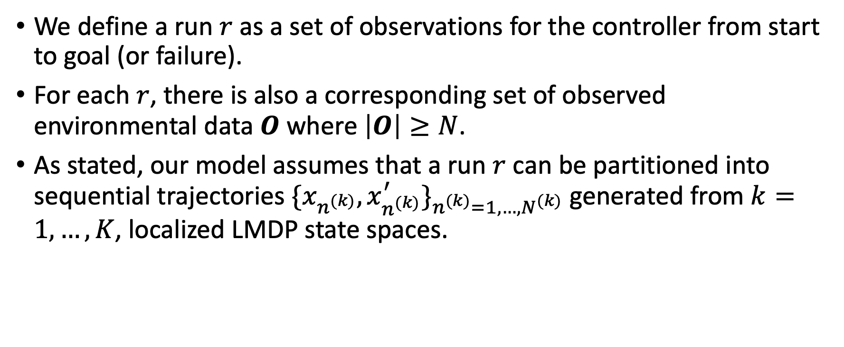
Partitioned Runs
We define a run $r$ as a set of observations for the controller from start to goal (or failure).
For each $r$, there is also a corresponding set of observed environmental data $O$ where $\left|O\right|≥N$.
As stated, our model assumes that a run $r$ can be partitioned into sequential trajectories ${\{x_{n^{(k)}},x_{n^{(k)}}^{′}\}}_{n^{(k)}=1,…,N^{(k)}}$ generated from $k=1,…,K$, localized LMDP state spaces.

Slide 66
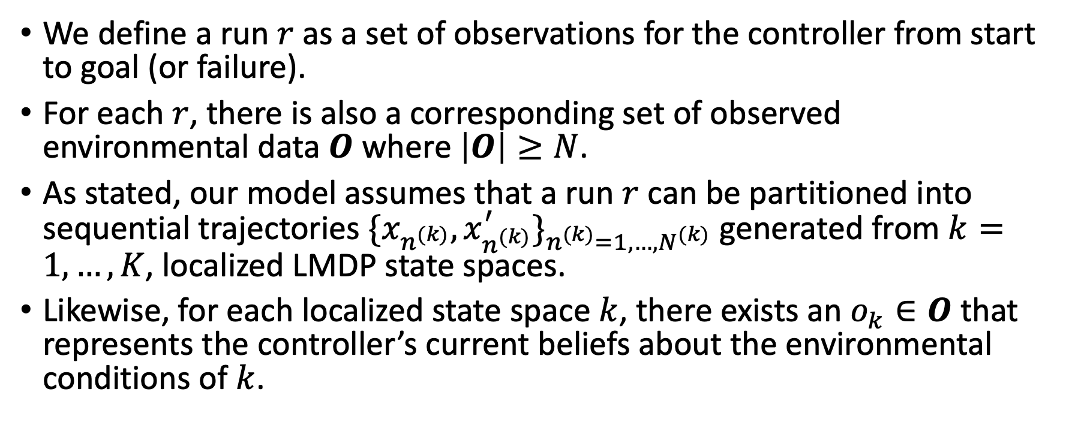
Partitioned Runs
We define a run $r$ as a set of observations for the controller from start to goal (or failure).
For each $r$, there is also a corresponding set of observed environmental data $O$ where $\left|O\right|≥N$.
As stated, our model assumes that a run $r$ can be partitioned into sequential trajectories ${\{x_{n^{(k)}},x_{n^{(k)}}^{′}\}}_{n^{(k)}=1,…,N^{(k)}}$ generated from $k=1,…,K$, localized LMDP state spaces.
Likewise, for each localized state space $k$, there exists an $o_{k}∈O$ that represents the controller’s current beliefs about the environmental conditions of $k$.

Slide 67
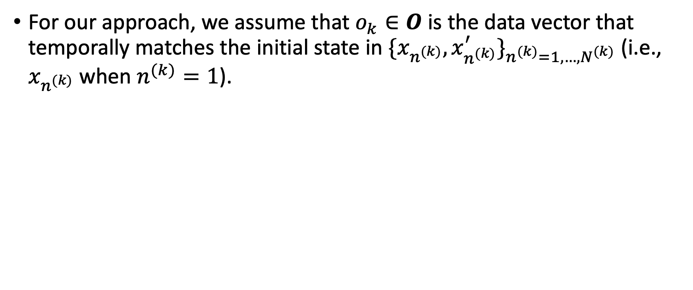
Assumptions
For our approach, we assume that $o_{k}∈O$ is the data vector that temporally matches the initial state in ${\{x_{n^{(k)}},x_{n^{(k)}}^{′}\}}_{n^{(k)}=1,…,N^{(k)}}$ (i.e., $x_{n^{(k)}}$ when $n^{(k)}=1$).

Slide 68
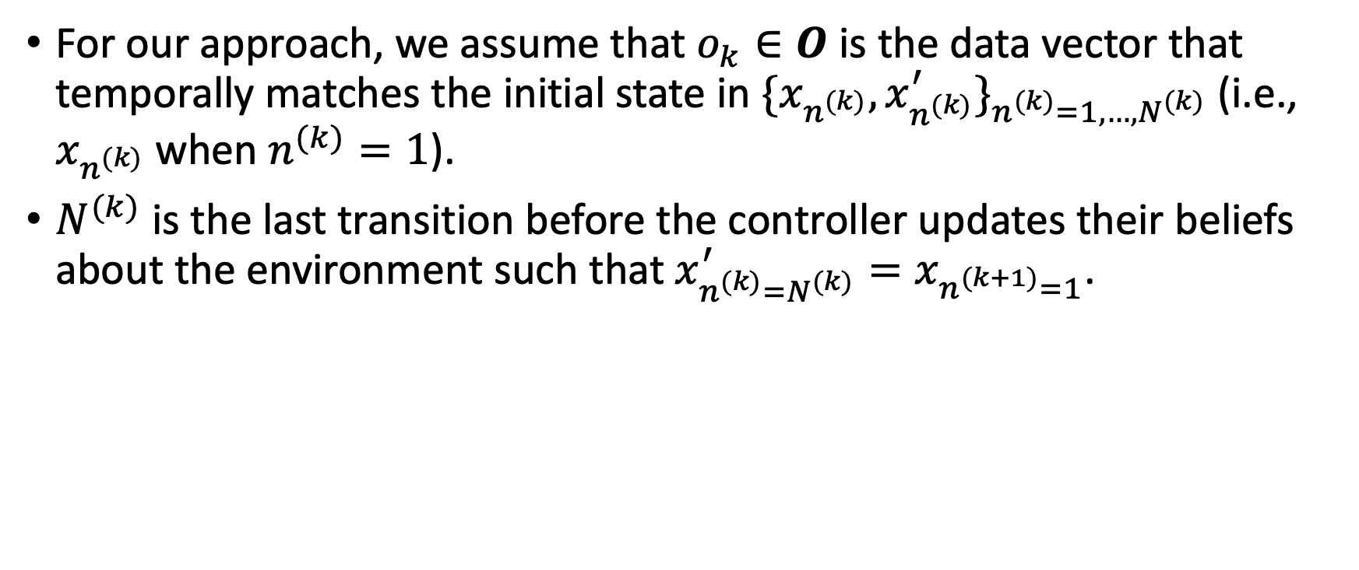
Assumptions
For our approach, we assume that $o_{k}∈O$ is the data vector that temporally matches the initial state in ${\{x_{n^{(k)}},x_{n^{(k)}}^{′}\}}_{n^{(k)}=1,…,N^{(k)}}$ (i.e., $x_{n^{(k)}}$ when $n^{(k)}=1$).
$N^{(k)}$ is the last transition before the controller updates their beliefs about the environment such that $x_{n^{(k)}=N^{(k)}}^{′}=x_{n^{(k+1)}=1}$.

Slide 69
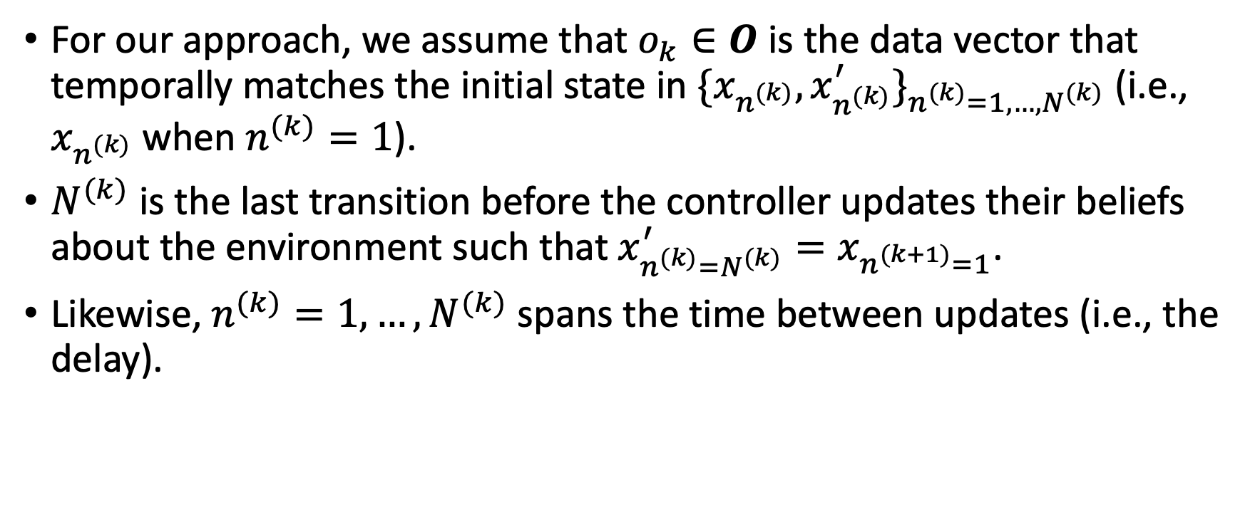
Assumptions
For our approach, we assume that $o_{k}∈O$ is the data vector that temporally matches the initial state in ${\{x_{n^{(k)}},x_{n^{(k)}}^{′}\}}_{n^{(k)}=1,…,N^{(k)}}$ (i.e., $x_{n^{(k)}}$ when $n^{(k)}=1$).
$N^{(k)}$ is the last transition before the controller updates their beliefs about the environment such that $x_{n^{(k)}=N^{(k)}}^{′}=x_{n^{(k+1)}=1}$.
Likewise, $n^{(k)}=1,…,N^{(k)}$ spans the time between updates (i.e., the delay).

Slide 70
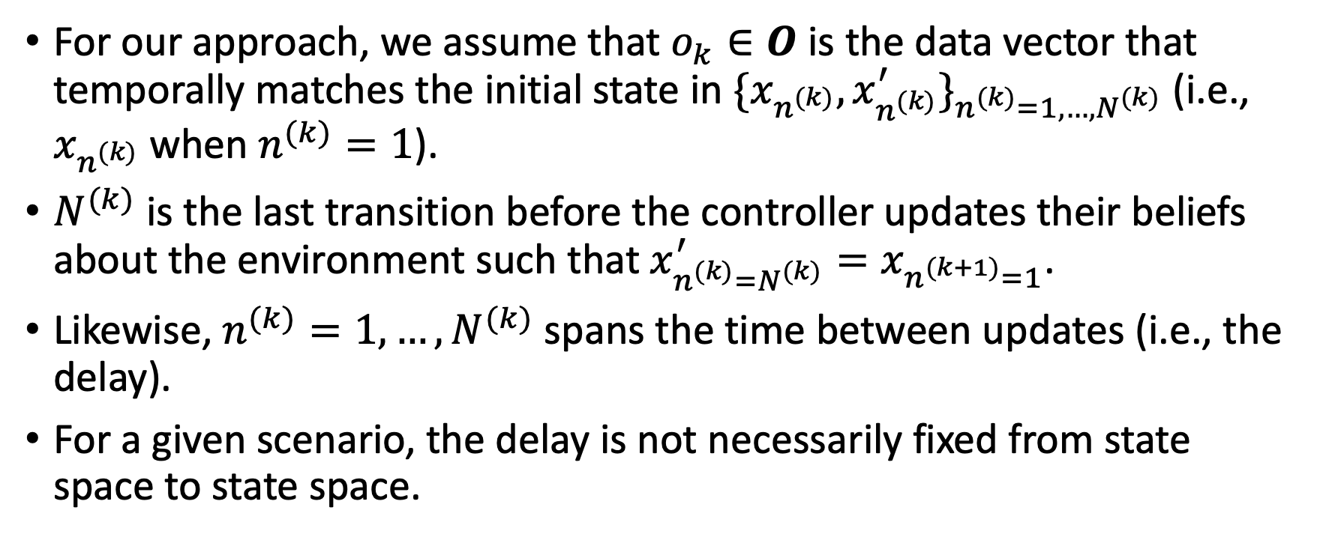
Assumptions
For our approach, we assume that $o_{k}∈O$ is the data vector that temporally matches the initial state in ${\{x_{n^{(k)}},x_{n^{(k)}}^{′}\}}_{n^{(k)}=1,…,N^{(k)}}$ (i.e., $x_{n^{(k)}}$ when $n^{(k)}=1$).
$N^{(k)}$ is the last transition before the controller updates their beliefs about the environment such that $x_{n^{(k)}=N^{(k)}}^{′}=x_{n^{(k+1)}=1}$.
Likewise, $n^{(k)}=1,…,N^{(k)}$ spans the time between updates (i.e., the delay).
For a given scenario, the delay is not necessarily fixed from state space to state space.

Slide 71
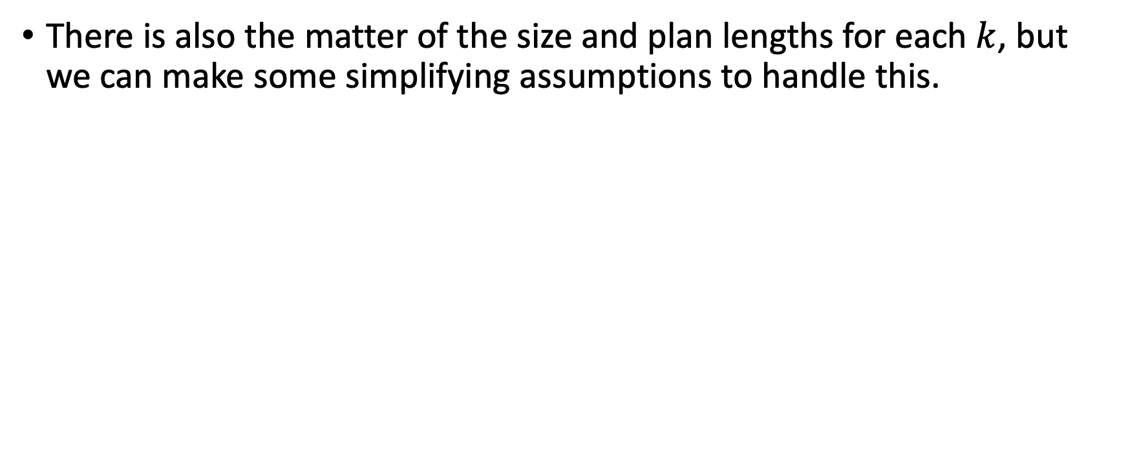
Assumptions
There is also the matter of the size and plan lengths for each $k$, but we can make some simplifying assumptions to handle this.

Slide 72
Simplifying Assumptions
First, however, we will discuss two properties of our model that justify these assumptions.

Slide 73
Simplifying Assumptions
First, however, we will discuss two properties of our model that justify these assumptions.
In the example, the controller interrupts their current plan for the shown localized state space and ends up only generating the trajectory in red.

Slide 74
Simplifying Assumptions
Due to the Markov Property of state transitions, the observed trajectory on the left has the same likelihood as the observed trajectory on the right.

Slide 75
Simplifying Assumptions
Due to the Markov Property of state transitions, the observed trajectory on the left has the same likelihood as the observed trajectory on the right.
Otherwise stated, it does not matter to an observer whether the planned trajectory was longer than the actual observed trajectory in terms of the likelihood of the observed trajectory.

Slide 76
Simplifying Assumptions
Likewise, an observed trajectory maintains its likelihood under a smaller state space if it preserves all potential trajectories of the same length (assuming the same initial state).

Slide 77
Simplifying Assumptions
Assuming in our example, that the particle can only move up, down, left, and right, we can preserve the likelihood of the observed trajectory on the left even if we shrink the state space to a Von Neumann Neighborhood of size 3 (i.e., the smallest possible state space that preserves all potential trajectories of length 3).

Slide 78
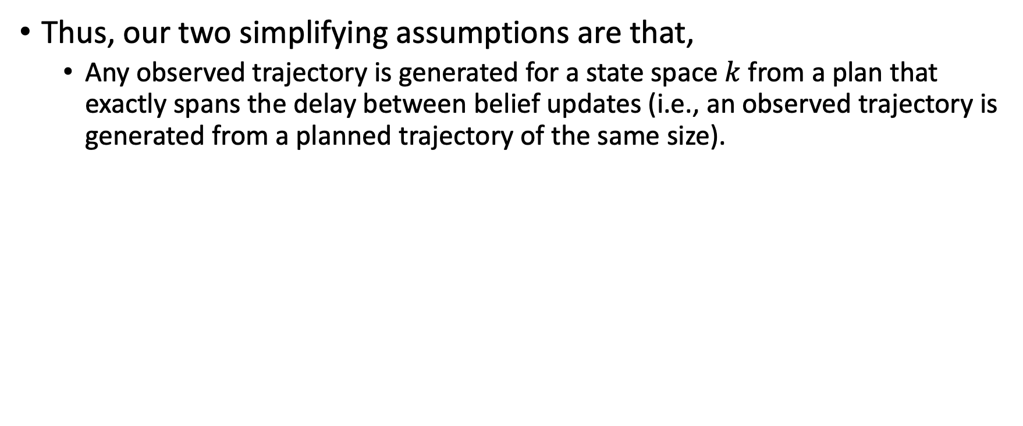
Simplifying Assumptions
Thus, our two simplifying assumptions are that,
Any observed trajectory is generated for a state space $k$ from a plan that exactly spans the delay between belief updates (i.e., an observed trajectory is generated from a planned trajectory of the same size).

Slide 79
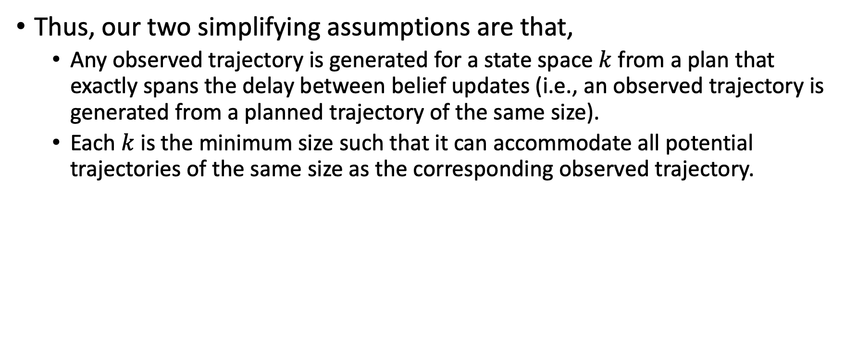
Simplifying Assumptions
Thus, our two simplifying assumptions are that,
Any observed trajectory is generated for a state space $k$ from a plan that exactly spans the delay between belief updates (i.e., an observed trajectory is generated from a planned trajectory of the same size).
Each $k$ is the minimum size such that it can accommodate all potential trajectories of the same size as the corresponding observed trajectory.

Slide 80
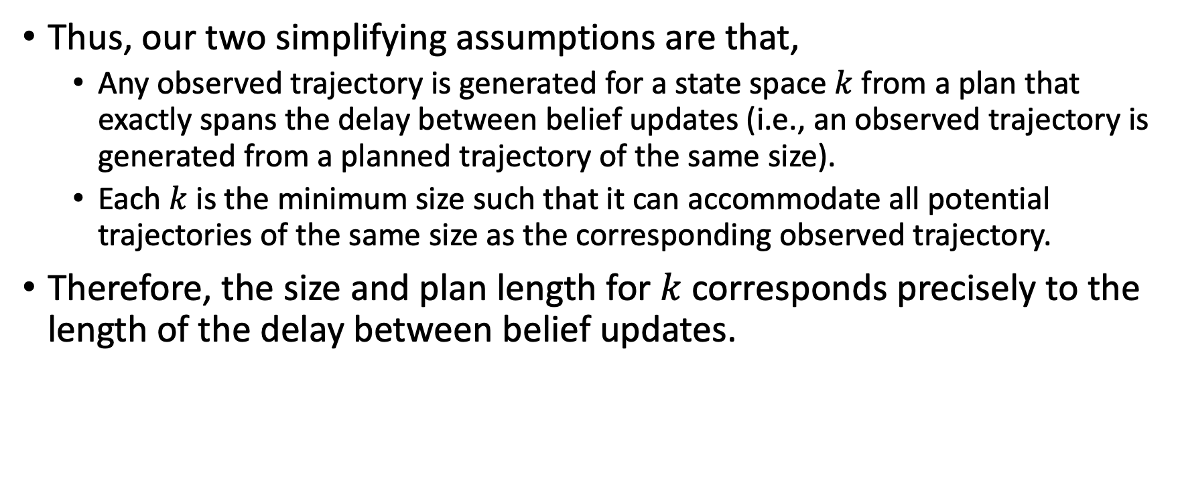
Simplifying Assumptions
Thus, our two simplifying assumptions are that,
Any observed trajectory is generated for a state space $k$ from a plan that exactly spans the delay between belief updates (i.e., an observed trajectory is generated from a planned trajectory of the same size).
Each $k$ is the minimum size such that it can accommodate all potential trajectories of the same size as the corresponding observed trajectory.
Therefore, the size and plan length for $k$ corresponds precisely to the length of the delay between belief updates.

Slide 81

Inverse Optimal Control for LMDPs with Delayed Observations

Slide 82
Inverse Optimal Control for LMDPs with Delayed Observations
Training over multiple runs can be handled by adding another exterior summation and normalizing constant over the number of runs.

Slide 83
Unknown Length of the Delay
In many scenarios, especially when observing human controllers, the actual length of the delay is unknown.

Slide 84

Unknown Length of the Delay
In many scenarios, especially when observing human controllers, the actual length of the delay is unknown.
By formulating this uncertainty about the delay as a multiple changepoint problem, we can infer the most likely partitioning of a run $r$.

Slide 85

Inferring Delayed Belief Updating
First, we assume that we can map a run $r$ to a global state space to get a global trajectory ${\{x_{n},x_{n}^{′}\}}_{n=1,…,N}$ such that this global trajectory that can be partitioned into sub-trajectories corresponding to $k=1,…,K$ localized state spaces.

Slide 86

Inferring Delayed Belief Updating
First, we assume that we can map a run $r$ to a global state space to get a global trajectory ${\{x_{n},x_{n}^{′}\}}_{n=1,…,N}$ such that this global trajectory that can be partitioned into sub-trajectories corresponding to $k=1,…,K$ localized state spaces.
Let $s_{k}=n$, such that $n$ indexes the end transition generated from the state space $k$, then for a run $r,$ $s_{1}<s_{2}<…<s_{K−1}<s_{K}$.

Slide 87

Inferring Delayed Belief Updating
First, we assume that we can map a run $r$ to a global state space to get a global trajectory ${\{x_{n},x_{n}^{′}\}}_{n=1,…,N}$ such that this global trajectory that can be partitioned into sub-trajectories corresponding to $k=1,…,K$ localized state spaces.
Let $s_{k}=n$, such that $n$ indexes the end transition generated from the state space $k$, then for a run $r,$ $s_{1}<s_{2}<…<s_{K−1}<s_{K}$.
Recall that there is also an environmental data vector $o_{k}∈O$ that corresponds to each state space $k$ as well.

Slide 88

Inferring Delayed Belief Updating
Although the number of state spaces $K$ is unknown, $s_{K}$ is the known quantity $N$ (i.e., the end transition for the run $r$), giving us $s_{1}<s_{2}<…<s_{K−1}<N$.

Slide 89

Inferring Delayed Belief Updating
Although the number of state spaces $K$ is unknown, $s_{K}$ is the known quantity $N$ (i.e., the end transition for the run $r$), giving us $s_{1}<s_{2}<…<s_{K−1}<N$.
Also, let the number of unknown partition points be $w=K−1$.

Slide 90

Inferring Delayed Belief Updating
Although the number of state spaces $K$ is unknown, $s_{K}$ is the known quantity $N$ (i.e., the end transition for the run $r$), giving us $s_{1}<s_{2}<…<s_{K−1}<N$.
Also, let the number of unknown partition points be $w=K−1$.
Thus, for our multiple changepoint problem we want to infer $(θ,s_{w},w)$ where $θ$ is the parameter vector for the loss function $L[θ]$, $s_{w}=(s_{1},…,s_{w}|w)$, and $w$ as previously defined.

Slide 91

Inferring Delayed Belief Updating
Although the number of state spaces $K$ is unknown, $s_{K}$ is the known quantity $N$ (i.e., the end transition for the run $r$), giving us $s_{1}<s_{2}<…<s_{K−1}<N$.
Also, let the number of unknown partition points be $w=K−1$.
Thus, for our multiple changepoint problem we want to infer $(θ,s_{w},w)$ where $θ$ is the parameter vector for the loss function $L[θ]$, $s_{w}=(s_{1},…,s_{w}|w)$, and $w$ as previously defined.
There are likely several methods for inferring $(θ,s_{w},w)$, but we demonstrate just one method here.

Slide 92


Inferring $s_{w}$ and $w$
Although $θ$ is independent from $s_{w}$ and $w$, if we knew the latter, then we could simply use a gradient-based optimization method to compute $θ_{MLE}$ (assuming $h(x^{′};θ)$ meets certain requirements).

Slide 93

Inferring $s_{w}$ and $w$
Although $θ$ is independent from $s_{w}$ and $w$, if we knew the latter, then we could simply use a gradient-based optimization method to compute $θ_{MLE}$ (assuming $h(x^{′};θ)$ meets certain requirements).
Using this idea, we write $θ_{MLE}$ as $θ_{MLE}(s_{w},w)$ (i.e., the MLE of $θ$ as a function of $s_{w}$ and $w$.

Slide 94

Inferring $s_{w}$ and $w$
Although $θ$ is independent from $s_{w}$ and $w$, if we knew the latter, then we could simply use a gradient-based optimization method to compute $θ_{MLE}$ (assuming $h(x^{′};θ)$ meets certain requirements).
Using this idea, we write $θ_{MLE}$ as $θ_{MLE}(s_{w},w)$ (i.e., the MLE of $θ$ as a function of $s_{w}$ and $w$.
By replacing $h(x^{′};θ)$ with $h\left(x^{′};θ_{MLE}\left(s_{w},w\right)\right)$ in $L[θ]$, we get a loss function $L[s_{w},w]$.

Slide 95

Inferring $s_{w}$ and $w$
Although $θ$ is independent from $s_{w}$ and $w$, if we knew the latter, then we could simply use a gradient-based optimization method to compute $θ_{MLE}$ (assuming $h(x^{′};θ)$ meets certain requirements).
Using this idea, we write $θ_{MLE}$ as $θ_{MLE}(s_{w},w)$ (i.e., the MLE of $θ$ as a function of $s_{w}$ and $w$.
By replacing $h(x^{′};θ)$ with $h\left(x^{′};θ_{MLE}\left(s_{w},w\right)\right)$ in $L[θ]$, we get a loss function $L[s_{w},w]$.
However, since $h\left(x^{′};θ_{MLE}\left(s_{w},w\right)\right)$ is not differentiable in terms of $s_{w}$ and $w$, gradient-based optimization will not work here.

Slide 96

Posterior Distribution of $s_{w}$ and $w$

Slide 97

Posterior Distribution of $s_{w}$ and $w$
Instead, we formulate the inference problem as computing the joint posterior distribution of $s_{w}$ and $w$where $D=({\left\{x_{n},x_{n}^{′}\right\}}_{n=1,…,N},O)$ and $P\left(D | s_{w},w\right)=exp⁡(−L\left[s_{w},w\right]+\sum_{k}{\sum_{n_{k}}{log⁡(π^{0}(x_{n_{k}}^{′}|x_{n_{k}}}}))$.

Slide 98

Posterior Distribution of $s_{w}$ and $w$
Instead, we formulate the inference problem as computing the joint posterior distribution of $s_{w}$ and $w$where $D=({\left\{x_{n},x_{n}^{′}\right\}}_{n=1,…,N},O)$ and $P\left(D | s_{w},w\right)=exp⁡(−L\left[s_{w},w\right]+\sum_{k}{\sum_{n_{k}}{log⁡(π^{0}(x_{n_{k}}^{′}|x_{n_{k}}}}))$.
The latter term was originally omitted from the loss function because it doesn’t depend on any of the unknown parameters.

Slide 99


Prior of $w$
Let $w\sim Poisson(λ)$ under the constraint that $w≤N−1$.

Slide 100


Prior of $s_{w}|w$
Given $w≤N−1,s_{1},…,s_{w}$ are distributed as the order statistics from $w$ points sampled uniformly from $1,…,N−1$ without repetition.
$P\left(s_{1},…,s_{w} | w\right)=\frac{w!\left(N−w−1\right)!}{\left(N−1\right)!}=\frac{Γ(w+1)Γ(N−w)}{Γ(N)}$

Slide 101


Computing $P(s_{w},w|D)$
Computing $P(s_{w},w|D)$ directly is infeasible, so we take a sampling approach.

Slide 102

Computing $P(s_{w},w|D)$
Computing $P(s_{w},w|D)$ directly is infeasible, so we take a sampling approach.
However, in most Bayesian Models, the size of the parameter space is fixed and known.

Slide 103

Computing $P(s_{w},w|D)$
Computing $P(s_{w},w|D)$ directly is infeasible, so we take a sampling approach.
However, in most Bayesian Models, the size of the parameter space is fixed and known.
But in our multiple changepoint problem we are uncertain about the number of partition points $w$ where each partition point is a parameter.

Slide 104

Computing $P(s_{w},w|D)$
Computing $P(s_{w},w|D)$ directly is infeasible, so we take a sampling approach.
However, in most Bayesian Models, the size of the parameter space is fixed and known.
But in our multiple changepoint problem we are uncertain about the number of partition points $w$ where each partition point is a parameter.
Our uncertainty about the size of the parameter space rules out any standard sampling implementations (e.g., Metropolis-Hastings, importance sampling, etc.).

Slide 105
Reversible Jump Markov Chain Monte Carlo
Instead, we employ a Markov Chain Monte Carlo (MCMC) algorithm called Reversible Jump Markov Chain Monte Carlo (RJMCMC).

Slide 106
Reversible Jump Markov Chain Monte Carlo
Instead, we employ a Markov Chain Monte Carlo (MCMC) algorithm called Reversible Jump Markov Chain Monte Carlo (RJMCMC).
RJMCMC is devised explicitly for inference problems where the number of parameters is unknown.

Slide 107
Reversible Jump Markov Chain Monte Carlo
Instead, we employ a Markov Chain Monte Carlo (MCMC) algorithm called Reversible Jump Markov Chain Monte Carlo (RJMCMC).
RJMCMC is devised explicitly for inference problems where the number of parameters is unknown.
As demonstrated in the original RJMCMC paper, this makes it perfect for multiple changepoint problems where the number of changepoints (i.e., partition points) vary.

Slide 108

RJMCMC Proposal Distribution
$m\sim Cat\left(\left\{P,w+1,w−1\right\},\left(π_{w},b_{w},d_{w}\right)\right)$, where $P$ is a move to change the position of a partition with probability $π_{w}$ and $w+1/−1$ to add/delete a partition with probability $b_{w}$ and $d_{w}$ (respectively), such that $π_{w}+b_{w}+d_{w}=1$.

Slide 109

RJMCMC Proposal Distribution
$m\sim Cat\left(\left\{P,w+1,w−1\right\},\left(π_{w},b_{w},d_{w}\right)\right)$, where $P$ is a move to change the position of a partition with probability $π_{w}$ and $w+1/−1$ to add/delete a partition with probability $b_{w}$ and $d_{w}$ (respectively), such that $π_{w}+b_{w}+d_{w}=1$.
$\left(s_{w^{′}}^{′},w^{′}\right)\sim q(s_{w^{′}}^{′},w^{′}|s_{w},w,m)$ (This distribution depends on which $m$ was sampled).

Slide 110

Other Assumptions and Constraints on the Proposal Distribution
$d_{0}=π_{0}=0$

Slide 111

Other Assumptions and Constraints on the Proposal Distribution
$d_{0}=π_{0}=0$
$b_{N−1}=π_{N−1}=0$

Slide 112

Other Assumptions and Constraints on the Proposal Distribution
$d_{0}=π_{0}=0$
$b_{N−1}=π_{N−1}=0$
It’s best to choose $b_{w}$ and $d_{w}$ such that,
$b_{w}=cmin\{1,\frac{p\left(w+1\right)}{p\left(w\right)}\}$
$d_{w+1}=cmin\{1,\frac{p\left(w\right)}{p\left(w+1\right)}\}$
$c$ should be as large as possible with the constraint that $b_{w}+d_{w}≤0.9$ for all $w=0,…,N−1$.
This ensures that $b_{w}p\left(w\right)=d_{w+1}p(w+1)$ (i.e., detailed balance in terms of $w$).

Slide 113

Computing c
If $λ<1$, let $c=\frac{1.8}{λ+2}$
If $λ≥1$ and $λ<N−1$, let $c=\frac{0.9(λ+1)}{2λ+1}$
If $λ≥1$ and $λ≥N−1$, let $c=\frac{0.9λ}{2λ−1}$

Slide 114

RJMCMC Position Change
$s_{j}\sim dunif[s_{1},s_{w}]$ where $dunif$ denotes the discrete uniform distribution.

Slide 115

RJMCMC Position Change
$s_{j}\sim dunif[s_{1},s_{w}]$ where $dunif$ denotes the discrete uniform distribution.
$s_{j}^{′}\sim dunif[s_{j−1}+1,s_{j+1}−1]$

Slide 116

RJMCMC Position Change
$s_{j}\sim dunif[s_{1},s_{w}]$ where $dunif$ denotes the discrete uniform distribution.
$s_{j}^{′}\sim dunif[s_{j−1}+1,s_{j+1}−1]$
Step 2 excludes the transitions at $s_{j−1}$ and $s_{j+1}$ to ensure there are no overlapping partition points. Additionally, $s_{0}$ can be considered a dummy partition before the first transition.

Slide 117


Position Change Acceptance Probability
$$\min\left\{1,\exp\left(L\left[s_{w},w\right]−\sum_{k}{\sum_{n_{k}}{π^{0}\left(x_{n_{k}}^{′} | x_{n_{k}}\right)}}−[L\left[s_{w}^{′},w\right]−\sum_{k^{′}}{\sum_{n_{k^{′}}}{π^{0}\left(x_{n_{k^{′}}}^{′} | x_{n_{k^{′}}}\right)}}]\right)\right\}$$
All other ratios end up being canceled out. Additionally, $w^{′}=w$ in this case.

Slide 118

Position Change Acceptance Probability (log)
$$\min\left\{0,L\left[s_{w},w\right]−\sum_{k}{\sum_{n_{k}}{π^{0}\left(x_{n_{k}}^{′} | x_{n_{k}}\right)}}−\left[L\left[s_{w}^{′},w\right]−\sum_{k^{′}}{\sum_{n_{k^{′}}}{π^{0}\left(x_{n_{k^{′}}}^{′} | x_{n_{k^{′}}}\right)}}\right]\right\}$$

Slide 119


RJMCMC Add Partition
$s^{∗}\sim dunif[1,N−1]∖s_{w}$
For some $j∈[0,w]$, $P\left(s^{∗}∈(s_{j},s_{j+1})\right)=1$. If accepted, $s^{∗}=s_{j+1}^{′}$ and $s_{j+1},…,s_{w}=s_{j+2}^{′},…,s_{w+1}^{′}$.

Slide 120

Add Partition Acceptance Probability
$$\min\left\{1,\frac{λd_{w+1}}{(w+1)b_{w}}exp\left(L\left[s_{w},w\right]−\sum_{k}{\sum_{n_{k}}{π^{0}\left(x_{n_{k}}^{′} | x_{n_{k}}\right)}}−[L\left[s_{w+1}^{′},w+1\right]−\sum_{k^{′}}{\sum_{n_{k^{′}}}{π^{0}\left(x_{n_{k^{′}}}^{′} | x_{n_{k^{′}}}\right)}}]\right)\right\}$$
Since no new parameters are generated by an indirect consequence of increasing the dimension of the parameter space (i.e., all new parameters are sampled directly from the proposal distribution), then no Jacobian ratio is needed.

Slide 121

Add Partition Acceptance Probability (log)
$$\min\left\{0,\log\left(λ\right)+\log\left(d_{w+1}\right)−\log\left(w+1\right)−\log\left(b_{w}\right)+L\left[s_{w},w\right]−\sum_{k}{\sum_{n_{k}}{π^{0}\left(x_{n_{k}}^{′} | x_{n_{k}}\right)}}−[L\left[s_{w+1}^{′},w+1\right]−\sum_{k^{′}}{\sum_{n_{k^{′}}}{π^{0}\left(x_{n_{k^{′}}}^{′} | x_{n_{k^{′}}}\right)}}]\right\}$$

Slide 122

RJMCMC Delete Partition
$s_{j}\sim dunif[s_{1},s_{w}]$
If accepted, $s_{j+1},…,s_{w}=s_{j}^{′},…,s_{w−1}^{′}$.

Slide 123

Delete Partition Acceptance Probability
$$\min\left\{1,\frac{wb_{w−1}}{λd_{w}}exp\left(L\left[s_{w},w\right]−\sum_{k}{\sum_{n_{k}}{π^{0}\left(x_{n_{k}}^{′} | x_{n_{k}}\right)}}−[L\left[s_{w−1}^{′},w−1\right]−\sum_{k^{′}}{\sum_{n_{k^{′}}}{π^{0}\left(x_{n_{k^{′}}}^{′} | x_{n_{k^{′}}}\right)}}]\right)\right\}$$

Slide 124

Delete Partition Acceptance Probability (log)
$$\min\left\{0,\log\left(w\right)+\log\left(b_{w−1}\right)−\log\left(λ\right)−\log\left(d_{w}\right)+L\left[s_{w},w\right]−\sum_{k}{\sum_{n_{k}}{π^{0}\left(x_{n_{k}}^{′} | x_{n_{k}}\right)}}−[L\left[s_{w−1}^{′},w−1\right]−\sum_{k^{′}}{\sum_{n_{k^{′}}}{π^{0}\left(x_{n_{k^{′}}}^{′} | x_{n_{k^{′}}}\right)}}]\right\}$$

Slide 125
Busy Beeway
Player max speed = 4 units per second
Obstacle speeds = (2,4,6,8) units per second at probabilities (0.25,0.34,0.25,0.15) (NEED TO CHECK THIS)

